Slide 1


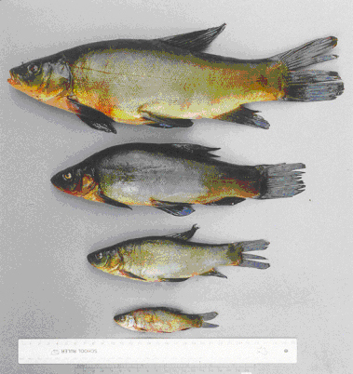
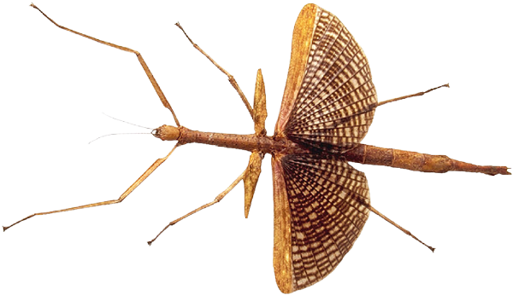
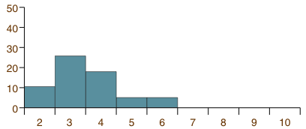

Percentage of catch
Age (years)
Ecology Series: Set 3
Copyright © 2005
Version: 1.0

Slide 2
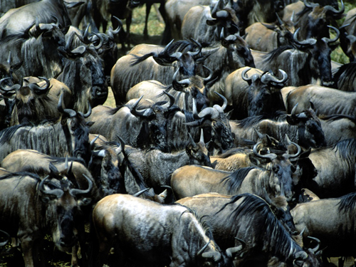
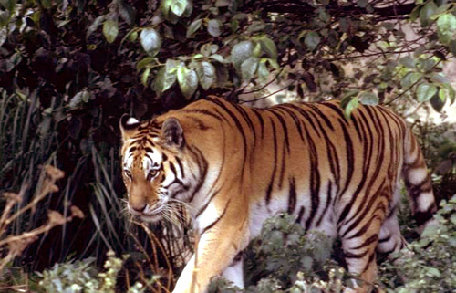

Populations
Organisms do not generally live alone. A population is a group of organisms from the same species occupying in the same geographical area.
This area may be difficult to define because:
  A population may comprise widely dispersed individuals which come together only infrequently, e.g. for mating.
  Populations may fluctuate considerably over time.
Migrating wildebeest population
Tiger populations comprise widely separated individuals

Slide 3
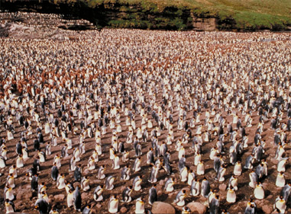
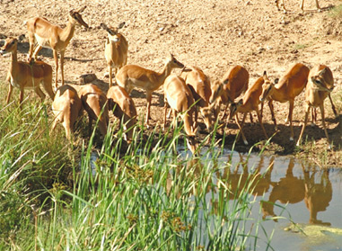
Features of Populations 1
Populations are dynamic and exhibit attributes that are not shown by the individuals themselves.
These attributes can be measured or calculated and include:
  Population size: the total number of organisms in the population.
  Population density: the number of organisms per unit area.
  Population distribution: the location of individuals within a specific area.

Slide 4
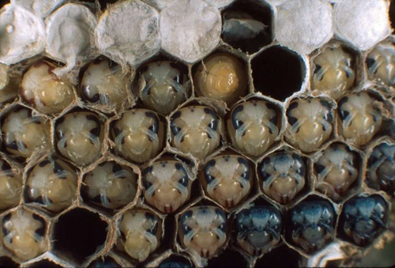
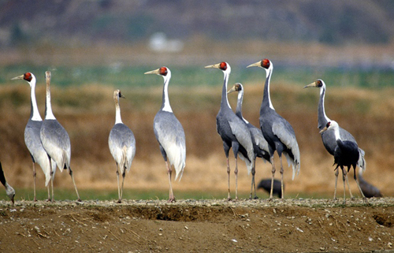
Features of Populations 2
Population composition provides information relevant to the dynamics of the population, i.e. whether the population is increasing or declining.
Information on population composition (or structure) includes:
  Sex ratios: the number of organisms of each sex.
  Fecundity (fertility): the reproductive capacity of the females.
  Age structure: the number of organisms of different ages.

Slide 5
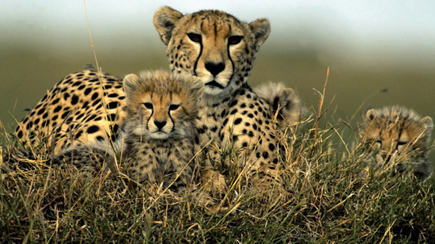
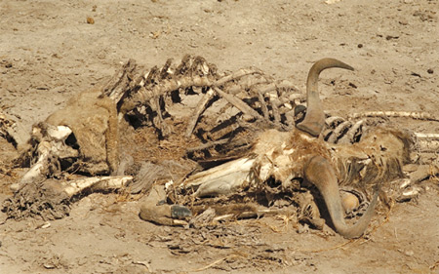
Population Dynamics
The study of changes in the size and composition of populations, and the factors influencing these changes, is population dynamics.
Key factors for study include:
  Population growth rate: the change in the total population size per unit time.
  Natality (birth rate): the number
  of individuals born per unit time.
  Mortality (death rate): the number of individuals dying per unit time.
  Migration: the number moving into or out of the population.
Population size is influenced by births…
…and deaths

Slide 6
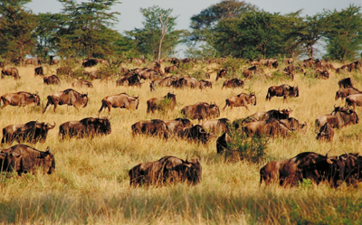
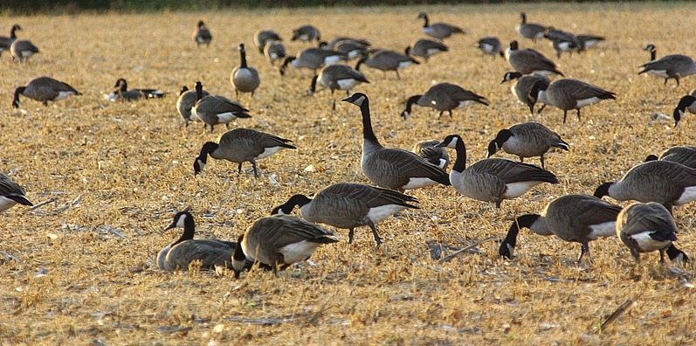
Migration
Migration is the movement of organisms into (immigration) and out of (emigration) a population. It affects population attributes such as age and sex structure, as well as the dynamics of a population.
  Populations lose individuals through deaths and emigration.
  Populations gain individuals through births and immigration.
Wildebeest
Canada geese
Migrating species may group together to form large mobile populations

Slide 7
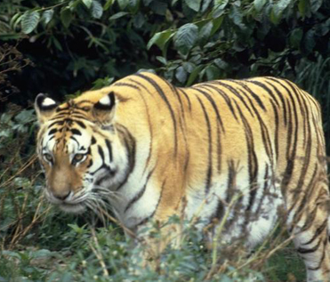
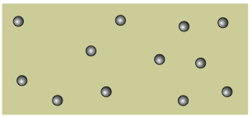
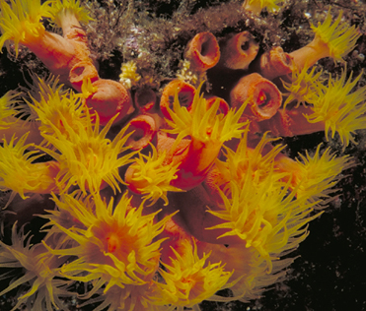
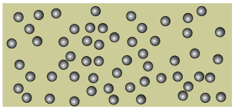
Population Density
The number of individuals per unit area (for terrestrial organisms) or volume (for aquatic organisms) is termed the population density.
  At low population densities, individuals are spaced well apart. Examples: territorial, solitary mammalian species such as tigers and plant species in marginal environments.
  At high population densities, individuals are crowded together. Examples: colonial animals, such as rabbits, corals, and termites.
Low density populations
High density populations

Slide 8
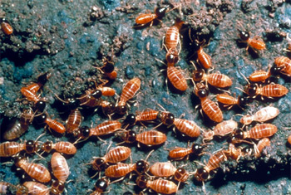
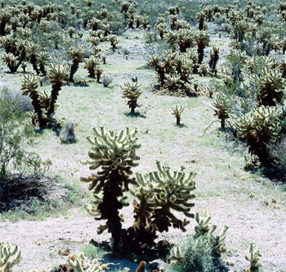
Population Distribution
A crude measure of population density tells us nothing about the spatial distribution of individuals in the habitat.
The population distribution describes the location of individuals within an area.
  Distribution patterns are determined by the habitat patchiness (distribution of resources) and features of the organisms themselves, such as territoriality in animals or autotoxicity in plants.
  Individuals in a population may be distributed randomly, uniformly, or in clumps.
Clumped distribution in termites
More uniform distribution in cacti

Slide 9
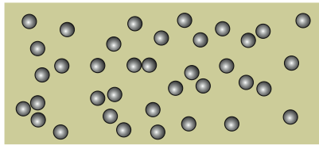
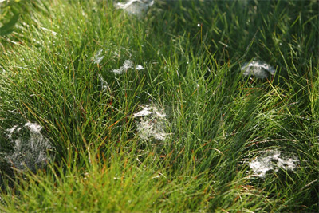
Random Distribution
A population’s distribution is considered random if the position of each individual is independent of the others.
Random distributions are not common; they can occur only where:
  The environment is uniform and resources are equally available throughout the year.
  There are no interactions between individuals or interactions produce no patterns of avoidance or attraction.
Random distributions are seen in some invertebrate populations, e.g. spiders and clams, and some trees.
Spider populations appear to show a random distribution

Slide 10
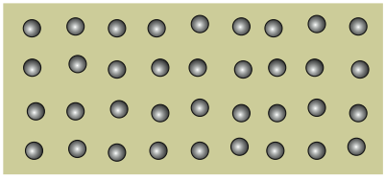
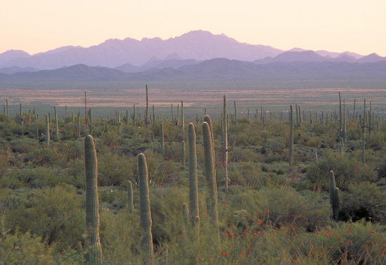
Uniform Distribution
Uniform or regular distribution patterns occur where individuals are more evenly spaced than would occur by chance.
Regular patterns of distribution result from intraspecific competition amongst members of a population:
  Territoriality in a relatively homogeneous environment.
  Competition for root and crown space in forest trees or moisture in desert and savanna plants.
  Autotoxicity: chemical inhibition of plant seedlings of the same species.
Saguaro cacti compete for moisture and show a uniform distribution

Slide 11
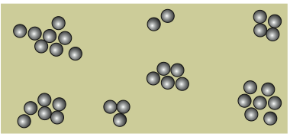
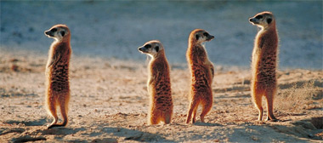
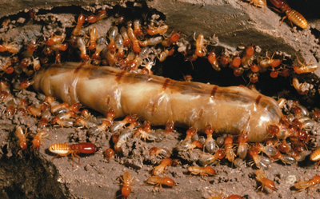
Clumped Distribution
Clumped distributions are the most common in nature; individuals are clustered together in groups.
Population clusters may occur around a a resource such as food or shelter.
Clumped distributions result from the responses of plants and animals to:
  Habitat differences
  Daily and seasonal changes in weather and environment
  Reproductive patterns
  Social behavior
Sociality leads to clumped distribution

Slide 12
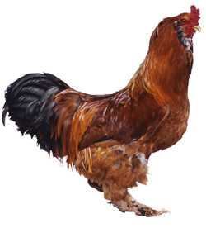


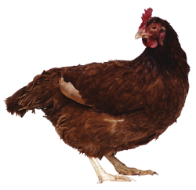


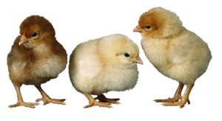
Population Regulation
Population size is regulated by environmental factors that limit population growth. These may be dependent or independent of the population density.
Density independent factors
DIRECTLY OR INDIRECTLY AFFECTS FOOD SUPPLY
Density dependent factors
Physical factors
e.g. rainfall
Catastrophic events
e.g. flood
Food supply
Disease
Competition
Predation
Regardless of population density, these are the same for all individuals
The effects of these factors are influenced by population density
Poor health or death
INCREASE IN MORTALITY
Change in ability to reproduce
NATALITY IS AFFECTED

Slide 13
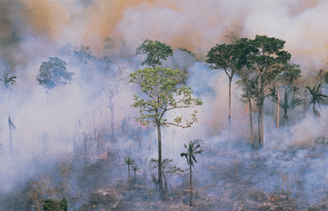
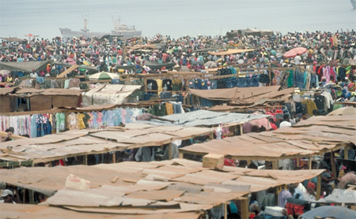
Environmental Factors
Environmental factors may be categorized according to how much population density influences their effect on population growth:
  Density independent factors have a controlling effect on population size and growth, regardless of the population density.
  Density dependent factors have an increasing effect on population growth as the density of the population increases.
Severe fires can result in high mortality
Humans often live at high density

Slide 14
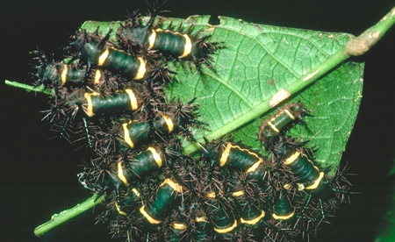
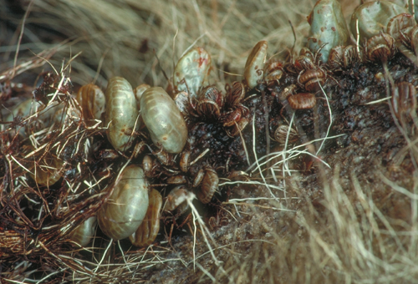
Density Dependent Factors
Density dependent factors exert a greater effect on population growth at higher population densities.
At high densities, individuals:
  Compete more for resources.
  Are more easily located by predators and parasites.
  Are more vulnerable to infection and disease.
Density dependent factors are biotic factors such as food supply, disease, parasite infestation, competition, and predation.
Competition increases in crowded populations
Parasites can spread rapidly through dense populations

Slide 15
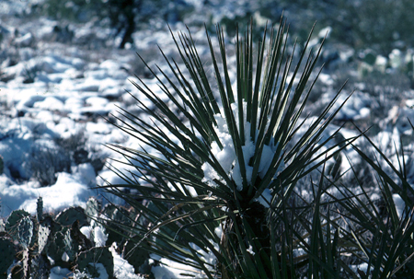
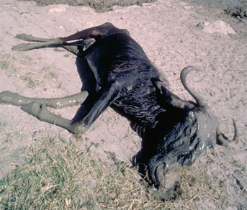

Density Independent Factors
The effect of density independent factors on a population’s growth is not dependent on that population’s density:
  Physical (or abiotic) factors
    temperature
    precipitation
    humidity
    acidity
    salinity etc.
  Catastrophic events
    floods and tsunamis
    fire
    drought
    earthquake and eruption

Slide 16
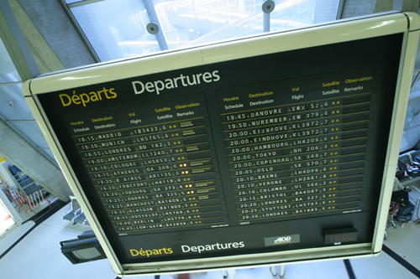
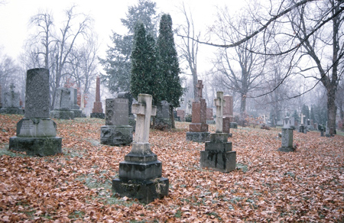
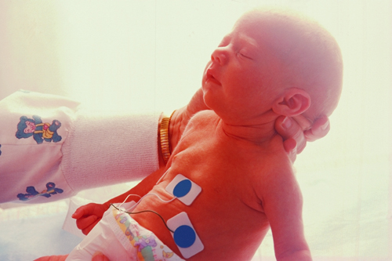
Population Growth
Population growth depends on the number of individuals added to the population from births and immigration, minus the number lost through deaths and emigration.
This can be expressed as a formula:
Net migration is the difference between immigration and emigration.
Population growth =
Births – Deaths + Immigration – Emigration
(B)
(D)
(I)
(E)

Slide 17
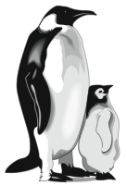
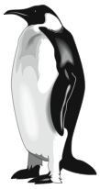
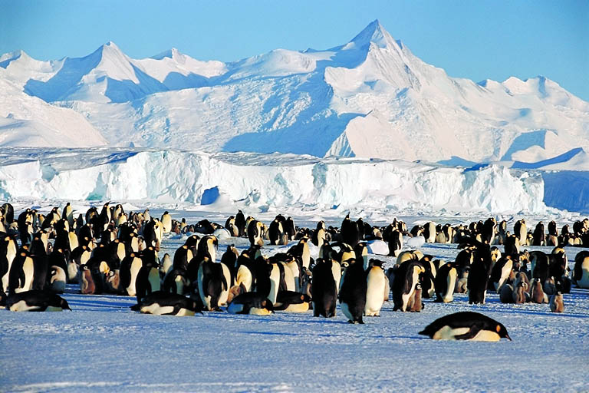
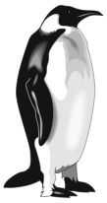

Calculating Population Change
Births, deaths, and net migrations determine the numbers of individuals in a population
Births (B)
Immigration (I)
Deaths (D)
Emigration (E)

Slide 18
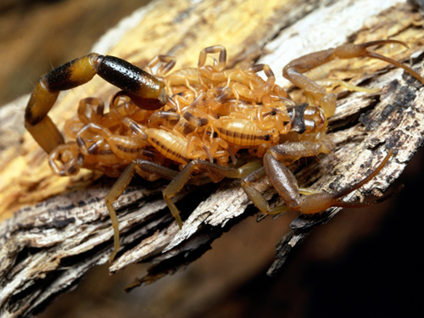
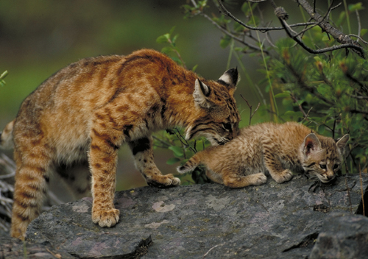
Rates of Population Change
Ecologists usually measure the rate of population change.
These rates are influenced by environmental factors and by the characteristics of the organisms themselves.
Rates are expressed as:
  Numbers per unit time,
  e.g. 2000 live births per year
  Per capita rate (number per head of population),
  e.g. 122 live births per 1000 individuals (12.2%)
Many invertebrate populations increase rapidly in the right conditions
Large mammalian carnivores have a lower innate capacity for increase

Slide 19
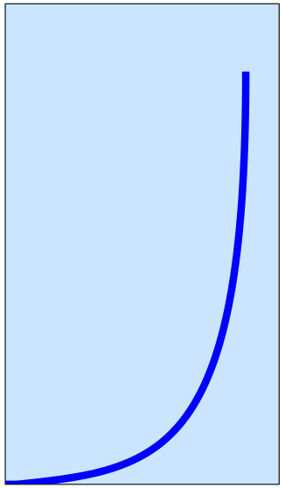
Exponential Growth
Populations becoming established in a new area for the first time are often termed colonizing populations.
  They may undergo a rapid exponential (logarithmic) increase in numbers to produce a J-shaped growth curve.
In natural populations, population growth rarely continues to increase at an exponential rate.
Factors in the environment, such as available food or space, act to slow population growth.
Colonizing Population
Here the number being added to the population per unit time is large.
Exponential (J) curve Exponential growth is sustained only when there are no constraints from the environment.
Population numbers (N)
Here, the number being added to the population per unit time is small.
Lag phase
Time

Slide 20
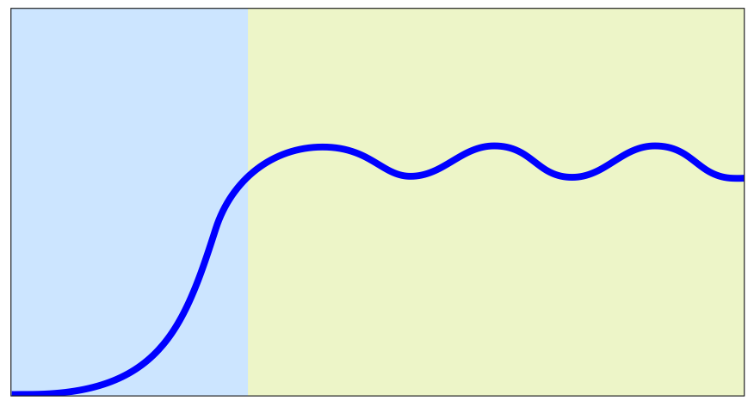
Logistic Growth
As a population grows, its increase will slow, and it will stabilize at a level that can supported by the environment.
This type of sigmoidal growth produces the logistic growth curve.
Established Population
The population encounters resistance to exponential growth as it begins to fill up the environment. This is called environmental resistance.
Environmental resistance increases as the population overshoots K.
Carrying capacity (K)
The population density that can be supported by the environment.
Logistic (S) curve
As the population grows, the rate of population increase slows, reaching an equilibrium level around the carrying capacity.
Population numbers (N)
Environmental resistance decreases as the population falls below K.
The population tends to fluctuate around an 'equilibrium level'. The fluctuations are caused by variations in the birth rate and death rate as a result of the population density exceeding of falling below carrying capacity.
Lag phase
In the early phase, growth is exponential (or nearly so)
Time

Slide 21
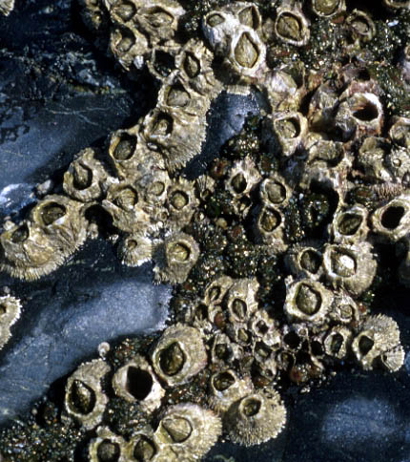
Life Tables
Numerical data collected during a population study can be presented as a table of figures called a life table.
Life tables provide a summary of mortality for a population. The basic data are the number of individuals surviving to each age interval. This gives the ages at which most mortality occurs in a population.
Life table for a population of the barnacle Balanus
Age (yr) | No. alive at the start of the age interval | Proportion of original no. surviving at the start of the age interval | No. dying during the age interval | Mortality (d)
0 | 142 | 1.000 | 80 | 0.563
1 | 62 | 0.437 | 28 | 0.452
2 | 34 | 0.239 | 14 | 0.412
3 | 20 | 0.141 | 5 | 0.250
4 | 15 | 0.106 | 4 | 0.267
5 | 11 | 0.078 | 5 | 0.454
6 | 6 | 0.042 | 4 | 0.667
7 | 2 | 0.014 | 0 | 0.000
8 | 2 | 0.014 | 2 | 1.000
9 | 0 | 0.0 | – | –

Slide 22
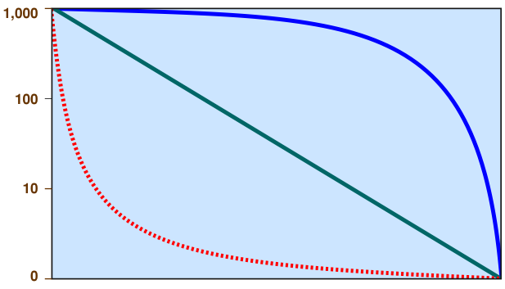


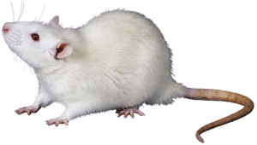
Survivorship Curves
The age structure of a population can represented with a
survivorship curve. Survivorship curves use a semi-log plot of the number of individuals surviving per 1000 in the population, against age.
  Because they are standardized (as number of survivors per 1000),
  species with different life expectancies can be easily compared.
  The shape of the curve reflects where heaviest mortality occurs:
Type I: late loss
large mammals
Type II: constant loss
small mammals, songbirds
Number of survivors (log scale)
Type III: early loss
oysters, barnacles
Relative age

Slide 23
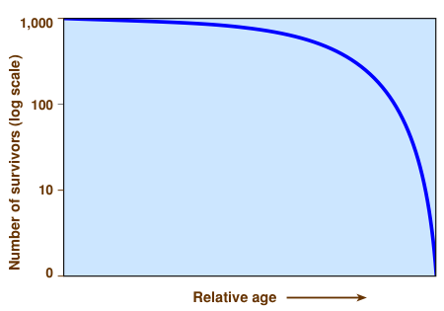

Type I Survivorship Curves
Species with Type I or late loss survivorship curves show the heaviest mortality late in life. Mortality is very low in the juvenile years and throughout most of adult life.
  Late loss curves are typical of species that produce few young and care for them until they reach reproductive age.
  Such species are sometimes called K selected species and include elephants, humans, and other large mammals.
Mortality is very low in early life
Mortality increases rapidly in old age

Slide 24


Type II Survivorship Curves
Species with Type II or constant loss survivorship curves show a relatively constant mortality at all life stages.
  Constant loss curves are typical of species with intermediate reproductive strategies. Populations face loss from predation and starvation throughout life.
  Examples include some many types of songbirds, some annual plants, some lizards, and many small mammals.
Constant mortality.
No one age class is any more susceptible than any other.

Slide 25


Type III Survivorship Curves
Species with Type III or early loss survivorship curves show the highest mortality in early life stages, with low mortality for those few individuals reaching a certain age and size.
  Early loss curves are typical of species that produce large number of offspring and lack parental care.
  Such species are r selected species (opportunists), and include most annual plants, most bony fish (although not mouth brooders), and most marine invertebrates.
Population losses are high in early life stages
Mortality is low for the few individuals surviving to old age

Slide 26



‘r’ and ‘K’ Selection
Two parameters govern the logistic growth of populations.
  The intrinsic rate of natural increase or biotic potential. This is the maximum reproductive potential of an organism, symbolized by the letter r.
  The saturation density or
  carrying capacity of the
  environment, represented
  by the letter, K.
We can characterize
species by the relative
importance of r and K
in their life cycles.
K-selected species
These species exist near asymptotic density (K) for most of the time. Competition and effective use of resources are important.
Population numbers (N)
r-selected species
These species rarely reach carrying capacity (K). Their populations are in nearly exponential growth phases for much of the year. Early growth, rapid development, and fast population growth are important.
Time

Slide 27

r-Selected Species
Correlates of r-selected species
Species with a high intrinsic capacity for population increase are called r-selected or opportunistic species.
  These species show certain life history features and, to survive, must continually invade new areas to compensate for being displaced by more competitive species.
  Opportunists include algae, bacteria, rodents, many insects, and most annual plants.
Climate | Variable and/or unpredictable
Mortality | Density-independent
Survivorship | Often type III (early loss)
Population size | Fluctuates wildly. Often below K.
Competition | Variable, often lax. Generalist niche.
Selection favors | Rapid development, high rm, early reproduction, small body size, single reproduction (annual)
Length of life | Short, usually less than one year
Leads to: | Productivity

Slide 28

K-Selected Species
Correlates of K-selected species
Species that are K-selected exist under strong competition and are pushed to use available resources more efficiently.
  These species have fewer offspring and longer lives.
  They put their energy into nurturing their young to reproductive age.
  K-selected species include most large mammals, birds of prey, and large, long-lived plants.
Climate | Fairly constant and/or predictable
Mortality | Density-dependent
Survivorship | Usually types I and II (late or constant loss)
Population size | Fairly constant in time. Near equilibrium with the environment.
Competition | Usually keen. Specialist niche.
Selection favors | Slower development, larger body size, greater competitive ability, delayed reproduction, repeated reproductions
Length of life | Longer (> one year)
Leads to: | Efficiency

Slide 29
Age Structure
Age structure refers to the number of organisms of different ages.
Populations can be broadly grouped into those individuals of:
  pre-reproductive age
  reproductive age
  post reproductive age
Analysis of the age structure of
populations can assist in their
management because it can
indicate where most population
mortality occurs and whether
or not reproductive individuals
are being replaced.
Size/age classes in tench

Slide 30



Age and Size in Fish
In some species, population age structure can be assessed by analyzing body size, which is related to age in a predictable way.
Individuals cluster together in age groups according to length or weight.
This method is used in analyzing the populations of commercially important fish species.
The population age structure shifts depending on the fishing pressure. Heavy fishing removes larger (older) individuals.
Heavy fishing
Percentage of catch
Age (years)
Moderate fishing
Percentage of catch
Age (years)
Light fishing
Percentage of catch
Age (years)

Slide 31



Thatch Palms
Golf Course
The age structure of populations of the thatch palm (Howea forsteriana) at three locations on Lord Howe Island was analyzed using stem height as an indication of age.
The differences in age structure between the three sites are mainly due to the extent of grazing at each site.
Percentage of population
Far Flats
% of Population
Lord Howe Is.
Grey Face
% of Population
Stem height (m)

Slide 32


Species Interactions
No organism exists in isolation. Each participates in interactions with other organisms and with the abiotic components of the environment.
Species interactions may involve only occasional or indirect contact (predation or competition) or they may involve a close association between species. Symbiosis is a term that encompasses a variety of such close associations, including parasitism (a form of exploitation), mutualism, and commensalism.
Canopy tree with symbionts attached
Oxpecker birds on buffalo

Slide 33


Types of Interaction

Slide 34


Parasitism
Many animal taxa have representatives that have adopted a parasitic lifestyle.
  Parasites occur more commonly in some taxa than in others. Insects, some annelids, and flatworms have many parasitic representatives.
Parasites live in or on a host organism. The host is always harmed by the presence of the parasite, but it is not usually killed. Both parasite and host show adaptations to the relationship.
Parasites may live externally on a host as ectoparasites, or within the host’s body as endoparasites.
Tick ectoparasite on bird wing
Many birds and mammals use dust bathing to rid themselves of external parasites

Slide 35




Ectoparasites
Ectoparasites, such as ticks, mites, lice, bed bugs, and fleas, live attached to the outside of the host, where they suck body fluids, cause irritation, and may act as vectors for pathogens.
Insect vectors include human lice, rat fleas, mosquitoes and tsetse flies.
Bed bug (Cimex lectularis)
Human flea (Pulex irritans)
Mosquito vector for Dengue fever (Aedes albopictus)
Head louse (Pediculus humanus)

Slide 36




Endoparasites
In many endoparasites, a primary host (in which the parasite becomes sexually mature) and one or more intermediate hosts (which usually house larval stages) are required to complete the life cycle.
Endoparasitic species such as the pork tapeworm, Taenia solium, are highly specialized to exploit the resources of the host.
  Adaptations, such as specialized mouthparts and lack of a digestive tract, enable them to spend their life inside the intestines of their vertebrate hosts.
Taenia scolex (head region)
Taenia proglottid (reproductive segment)
Horse gut nematode
Sheep liver fluke

Slide 37


Tapeworm Adaptations
Features of the pork tapeworm, Taenia solium, illustrate typical cestode adaptations.
Humans are the only primary host. Proglottids containing eggs are passed in the feces to be ingested by a pig. They hatch and are reingested when the pig flesh is eaten by humans.
The worm is simply a specialized head region (scolex) and a series of proglottids which are shed into the feces. There is no gut and respiration is anaerobic.
Hooks
Sucker
Hooks and suckers attach the worm to the host’s gut wall
Ripe proglottid containing eggs

Slide 38


Mutualistic Relationships
Mutualistic relationships occur between some birds (such as oxpeckers) and large herbivores (such as zebra, Cape buffalo, and rhinoceros). The herbivore is cleaned of parasites and the oxpecker gains access to food.
Lichens are an obligate mutualism between a fungus and either a green alga or a cynobacterium. The fungus obtains organic carbon from the alga. The alga obtains water and nutrient salts from the fungus.
Cape buffalo and oxpecker birds
Lichen: an obligate mutualism

Slide 39


Commensal Relationships
In commensal relationships, one party (the commensal) benefits, while the host is unaffected.
Epiphytes (perching plants) gain access to a better position in the forest canopy, with more light for photosynthesis, but do no harm to the host tree.
Commensal anemone shrimps (Periclimenes spp.) live within the tentacles of host sea anemones. The shrimp gains protection from predators, but the anemone is neither harmed nor benefitted.

Slide 40

Amensalism
Amensalism describes the situation where the presence of one species has a harmful effect on the other, but is not itself affected by the association.
In this respect, it is opposite to the relationship between a commensal and its host.
Grazing mammals trample and destroy vegetation around waterholes, creating bare zones. The mammals are unaffected by the loss as they go there primarily to drink and not to feed.

Slide 41



Exploitation
Exploitation describes relationships where one species benefits at the expense of another. It includes several familiar interactions:
  Predation: Predator kills the prey outright, e.g. lions hunting zebra.
  Herbivory: The herbivore feeds on, but usually does not kill, the plant, e.g. zebra grazing on grass.
  Parasitism: The parasite does not usually kill its host, e.g. ticks feeding on the blood of a zebra.

Slide 42



Plant Parasites
A great diversity of plant parasites exist. Some depend only partly on their host plant for nutrition; they are photosynthetic but utilize the host’s nutrients, e.g. mistletoe.
Others are entirely parasitic and are unable to photosynthesize, e.g. cancer root (Conopholis americana) dodder, and wood rose (Dactylanthus taylorii).
Cancer root (top) and wood rose are holoparasitic and dependent entirely on the host plant.
Mistletoe Phoradendren spp. are hemiparasites; photosynthesizing but lack their own roots and rob their host plant of water and nutrients.

Slide 43


Antibiosis
Antibiosis describes the chemical inhibition of one party by another. One party is harmed; the other is unaffected, or may even benefit.
In allelopathy, one plant releases toxic compounds (e.g. phenols or alkaloids) which inhibit the growth of nearby plants. Allelopathic plants include black walnut, swamp chestnut oak, and eucalyptus and neem trees. In cases of autotoxicity, a parent plant produces chemicals to inhibit the growth of its own seedlings.
Fungi produce antibiotics to inhibit the growth of bacteria.
Inhibition around a eucalypt
Many moulds produce antibiotics

Slide 44


Competition
Competition is one of the most familiar of species relationships. It occurs both within (intraspecific) and between (interspecific) species.
Individuals compete for resources such as food, space, and mates. In all cases of competition, both parties (the competitors) are harmed to varying extents by the interaction.
Neighboring plants compete for light, water, and nutrients. Interactions involving competition between animals for food are dominated by the largest, most aggressive species (or individuals).

Slide 45


Intraspecific Competition
Environmental resources are finite. Competition within species for resources increases as the population grows. At carrying capacity (K), it reduces the per capita growth rate to zero.
When the demand for a resource (e.g. water, food, nesting sites, light) exceeds supply, that resource becomes a limiting factor.
Animals compete for resources such as water (left) or mates (right), especially when these are in short supply or access to them is restricted.

Slide 46


Responses to Competition 1
Populations respond to resource limitation by reducing their population growth rate through lower natality or higher mortality.
Individuals respond variably to resource limitation.
  In most cases, food shortage reduces both individual growth rate and survival, as well as population growth.
  In many invertebrates and some vertebrates such as frogs, individuals reduce growth rate and mature at a smaller size.
Tadpoles metamorphosing into frogs
Trout are smaller when food limited

Slide 47




Responses to Competition 2
In some species, including frogs and butterflies, adults and juveniles reduce the intensity of intraspecific competition by exploiting different food resources. There may even be one or more non-feeding stages.
Caterpillars of the Atlas moth feed on a variety of tree species, but the adults do not feed. The adults of other species feed on nectar.
The aquatic tadpoles frogs feed on algae whereas the adults are carnivorous and feed exclusively on live invertebrates.

Slide 48


Competition for Mates
Intraspecific competition may be for mates or breeding sites. Ritualized display behavior and exaggerated coloration may be used to compete successfully.
During the breeding season, some species occupy small territories called leks, which are used solely for courtship display. The best leks attract the most females to the area.
In some vertebrates, territoriality spaces individuals apart so that only those with adequate resources are able to breed.
The egret’s courtship display exposes the lacy breeding plumage
Topi use leks for courtship

Slide 49





Golden Eagle Competition
Territoriality in birds and other animals is usually a consequence of intraspecific competition. This often produces a pattern of uniform distribution over an area of suitable habitat.
Golden eagle (Aquila chrysaetos)
breeding territories in Northern Scotland,1967
Single site
Group of sites belonging to one pair
Breeding, year of survey 1967
Marginal site, not regularly occupied
Low ground unsuitable for breeding eagles

Slide 50


Competition in Groups
Animals may form rather loose associations or live in well organized social groups. The nature of the competition is different in each case:
  Scramble competition occurs when members of the same species compete directly for an available resource. Some or all of the individuals may not acquire adequate resources.
  Contest competition occurs in social groups with hierarchical structures. Dominant individuals receive adequate resources, but subordinate individuals must contest what remains.
Scramble competition in caterpillars
Contest competition in wolves

Slide 51


Competition in Tadpoles
In tank populations of tadpoles (Rana tigrina), individual growth rate declines as the density increases from 5 to 160 individuals (in the same sized space). At high densities, tadpoles grow more slowly, taking longer to reach the minimum size for metamorphosis and decreasing their chances of successfully reaching adulthood.
Scramble competition in tadpoles of Rana tigrina
Minimum size for metamorphosis: 0.75 g
High density increases scramble competition. At high densities, no tadpoles have adequate food.

Slide 52


Interspecific Competition
Species with similar niche requirements may coexist naturally through niche differentiation, e.g. developing slightly different habitat or feeding preferences.
When two similarly adapted species, which do not naturally coexist, are brought into direct competition,
one will usually benefit at the
expense of the other.
In Britain, introduction of the larger, more aggressive, American gray squirrel in 1846 was followed by a steady contraction in the range
of the native red squirrel.
Red squirrel
(Sciurus vulgaris)
Gray squirrel
(Sciurus carolinesis)

Slide 53



Range Contraction in Squirrels
In the 44 years since the 1940 distribution survey, the more adaptable gray squirrel has displaced populations of the native red squirrels over much of the British Isles, particularly in the south.
1940
1984
Red squirrel
Gray squirrel
Region of range overlap
Today, healthy populations of red squirrels exist only in the forests of Ireland, Scotland, and in the north-east and north-west of England.

Slide 54



Predator-Prey Interactions
Most predators have more than one prey species, although one may be preferred. As one prey species becomes scarce, predation on other species increases (prey switching), so the proportion of each prey species in the predator’s diet fluctuates.
Where one prey species is the principal food item, and there is limited opportunity for prey switching, fluctuations in the prey population may closely govern predator cycles.

Slide 55


The Role of Prey Switching
Vertebrate predators rarely control their prey populations. Prey species tend to show regular population cycles in response to other factors and predators track these cycles.
Predators usually have a preferred prey species, but will switch to other prey when that species is rare.
Generalist predators can maintain stable populations by prey switching in response to changing prey densities.
Voles are the preferred prey of red foxes, but they will take other prey as well
Brown bears are true generalists and feed according to availability

Slide 56

Predator-Prey Cycles
Mammals frequently exhibit marked population cycles of high and low density that have a certain, predictable periodicity.
Regular trapping records of the Canada lynx over a 90 year period revealed a cycle of population fluctuations that repeated every 10 years or so (below). These oscillations closely matched, with a lag, the cycles of their principal prey item, the snowshoe hare.

Slide 57


Lynx and Hare
The population fluctuations of snowshoe hares in Canada have a periodicity of 9-11 years.
Population cycles of Canada lynx in the area show a similar periodicity.
The cycles appeared to be an example of long term predator-prey interaction.
  It is now known that hare fluctuations are characteristic of boreal regions. They are governed by the supply of suitable browse and synchronized by a solar cycle.
  Lynx numbers fluctuate with those of the hares (their principal prey), but the cycles are not coupled.
Snowshoe hares are dependent upon suitable woody browse
Snowshoe hares are the primary prey of Canada lynx.

Slide 58


Population Explosions
The crown-of-thorns starfish (Acanthaster planci) is a predator of the corals of the Great Barrier Reef. Sudden increases in the numbers of starfish on the reef have been recorded several times in the past.
Starfish populations fluctuate from very low numbers to major outbreaks (densities in excess of 30 starfish per hectare). Outbreaks can lead a major reduction in coral cover on the reef.
Crown-of-thorns starfish attacking coral
Crown-of-thorns
Abundance
Coral
Time
Generalized plot of change in abundance of starfish and its coral prey during an outbreak

Slide 59


Causes of Outbreaks
The causes of explosions in the crown-of-thorns starfish populations are not known.
It was thought that shell collecting caused a decline in the numbers of triton shells, which prey on the starfish. However, tritons have a varied diet and they have never been common anyway.
At present, there is no clear evidence to indicate that predation can limit the density of starfish. Outbreaks are probably a naturally recurring phenomenon.
Crown-of-thorns starfish, Acanthaster planci
Triton shell Charonia tritonis

Slide 60


Capturing Prey 1
Predators have acute senses with which to identify and locate prey. Many also have teeth, claws, or venom to catch and subdue prey.
Predators have also evolved various strategies for prey capture:
Filter feeding: Many marine animals such as barnacles, sponges, baleen whales, and manta rays filter the water to extract plankton.
Group attack: Dolphins and pelicans herd fish into ‘killing zones’ where they are more vulnerable to mass attack.

Slide 61



Capturing Prey 2
Tool use: Chimpanzees use twigs or grass stalks to extract termites from their holes.
Traps: Web spiders spin strong sticky threads to trap flying insects.
Speed: Cheetah outrun prey and match evasive maneuvers over short distances.

Slide 62



Capturing Prey 3
Lures: Angler fish, glow worms, and some spiders use lures to attract prey to within striking range.
Stealth: Many predators, including rattlesnakes, hunt by stealth. A rattlesnake’s ability to locate prey at night is greatly helped by the presence of infrared sense.
Concealment: Mantids use camouflage and stealth to surprise their prey.

Slide 63


Avoiding Predators
Just as predators have strategies for locating and capturing prey, prey have counter strategies to avoid being detected, subdued, and eaten.
  Some defenses, such as camouflage and hiding, involve no direct interaction with the predator.
  Other defenses, such as mobbing or fighting, involve the prey interacting directly with the predator.
  Animals often employ more than one strategy, with fighting usually being the least preferred option.
Group vigilance and alarms in meerkats
Hiding is a common strategy of fawns

Slide 64



Visual Deception
Markings, such as fake eyes, momentarily deceive predators as to the nature of their prey, allowing prey to escape.
Camouflage is used to avoid detection.
Adaptations in form, color, patterning, and behavior enable prey species to blend into their surroundings.
Owl butterfly
Leaf insect
Butterfly fish

Slide 65


Group Defense
Individuals within large groups are each less vulnerable to attack than they would be if alone.
Large flocks of birds and schools of fish tend to move together as one mass in a way that confuses predators and makes the isolation of individuals difficult.
Large groups also provide greater surveillance;
a predator is much less likely to approach a large group undetected.
Flamingoes congregate in large flocks
Large schools confuse predators

Slide 66


Chemical Defense
Chemical defenses are common in both vertebrate and invertebrate taxa. Noxious or toxic fluids are directed at attackers, deterring them and allowing the prey to escape.
  Many insects, including the Bombadier beetle and pentatomid bugs (stink bugs), exude or spray a noxious fluid when attacked.
  North American skunks can squirt a strongly smelling, nauseous fluid from their anal glands, at would-be attackers.
Pentatomid (stink) bug
North American skunk

Slide 67


Venomous Species
Many species, including snakes, spiders, and scorpions, produce venom, which is usually used both for prey capture and defense.
Many venomous species bite or sting in defense only as a last resort. Such species rely primarily on their cryptic coloration and behavior to remain undetected.
Rattlesnakes have a venomous bite, but rely first on camouflage and a warning rattle.
A scorpion’s defensive posture warns potential attackers of its venomous sting.

Slide 68



Warning Colors
Arrow poison frog
Many prey species taste bad, are toxic, or inflict pain on attackers.
Truly toxic or noxious species, such as arrow poison frogs and skunks, make little or no attempt to conceal themselves from predators. Instead, they often have warning (aposematic) coloration.
The conspicuous patterns and colors advertise their
unpalatability to predators.
Lionfish
Monarch butterfly

Slide 69


Batesian Mimicry
Many prey species resemble unpalatable, toxic, or dangerous species. These resemblances are forms of mimicry.
In Batesian mimicry, a harmless,
palatable species resembles a toxic or
dangerous species. Mimics benefit
because predators avoid all individuals
with a similar appearance.
  For Batesian mimicry to be effective, the mimic must not significantly outnumber the model. Predators must have a greater chance of encountering the unpalatable species.
The dangerous common wasp
…and its harmless Batesian mimic, the wasp beetle

Slide 70


Müllerian Mimicry
In Müllerian mimicry, unpalatable species tend to resemble each other. The mimics present a common image for predators to avoid.
Orange and black, or yellow and black are common warning colors in insects. The repetition of similar patterning and color in several species provides reinforcement to any potential predators.
  Butterfly species in the genus Danaus are toxic and share a similar appearance. They are Müllerian mimics.
Monarch butterfly: Danaus plexipus
Queen butterfly: Danaus gillipus

Slide 71



Structural Weaponry
Hard structures, such as horns, hooves, tusks, and antlers, enable prey species to defend themselves if confronted. Such weaponry is commonly seen in deer, antelope, and pigs.
Some animals have spines that act as deterrents to attack. These species may also erect their spines and take up a defensive posture if threatened. Examples include hedgehogs, spiny sea urchins, puffer fish and burrfish, and porcupines.
Webbed burrfish
Spiny sea urchin
Elk (male)

Slide 72



Body Armor
Stag beetle
Tough outer coverings, such as shells, are common in several taxa, especially arthropods, mollusks, and Chelonian reptiles.
Such armory is often accompanied by behaviors that serve to protect the vulnerable parts of the body.
  Almost all mollusks have protective shells. The head and muscular foot can be withdrawn into the shell.
  Turtles and tortoises (Order Chelonia) are characterized by their hard, protective shell, virtually their only defense.
Pill millipede
Tortoise

Slide 73

Responses to Detection
When cornered, an organism’s survival may depend on disorientating its predator. Rapid escape and startle displays are common strategies:
Startle displays: Many insects and reptiles rely on a sudden dramatic display to confuse a predator. The display may increase the apparent size of the prey, as in frilled lizards and stick insects, or it may expose a confusing image (such as fake eyes).
Detection and escape: Vulnerable species with few defenses, such as small rodents and grasshoppers, respond to danger by rapid movements in an unpredictable direction.
Stick insects rear up and fan their wings
Rodents run and jump unpredictably

Slide 74


The Evolutionary Arms Race
Morphology and behavior are shaped by natural selection.
Predation provides strong selective pressure on prey populations to evolve effective defense mechanisms, e.g.…
  greater speed and agility
  better surveillance
In turn, natural selection favors counter-adaptations in predator populations, e.g.…
  group cooperation
  greater stealth
Slower, more vulnerable individuals are often those that fall prey to predators
Natural selection favors the more capable hunters

Slide 75


Slide 76
Terms of Use
Biozone International retains copyright to the intellectual property included in this presentation file, with acknowledgement that certain photos are used under license and are credited appropriately on the next screen.
You MAY:
  Use these slides for presentations in your classrooms using a data projector, interactive whiteboard, and overhead projector.
  Place these files on the school’s intranet (school computer network), but not in contradiction of clause 3 (a) below.
  Edit and customize this file by adding, deleting, and modifying information to better suit your needs.
  Place these presentation files on any computer within the school, including staff laptops.
  Print out this file in PowerPoint “Handouts” format as per the print dialogue box, for the express purpose of allowing students to make their own notes about the presentation.
You MAY NOT:
  Put these presentation files onto the internet or on a service that may be accessed offsite from the campus, unless access to the service is protected by a user login and password protocol.
  Print these files onto paper to make your own worksheets for distribution to students.
  Create a NEW document using any of the graphics/images in this presentation file.
  Incorporate any part of this presentation file for the production of another commercial product.
  REMOVE any of the references to Biozone, the copyright notices, photo credits, or terms of use from this file.

Slide 77
Photo Credits
Photographic images are used under license from the following photo libraries:
  Corel Corporation Professional Photos
  ArtToday.com
  Clipart.com
  Hemera Technologies Inc.
  PhotoObjects.com
Additional artwork and photographs are the property of Biozone International Ltd.
BIOZONE International Ltd | P.O. Box 13-034, 109 Cambridge Road, Hamilton, NEW ZEALAND
Phone: + 64 7 856-8104 | Fax: + 64 7 856-9243 | E-mailsales@biozone.co.nz | Internet: www.biozone.co.nz
Copyright © 2005 Biozone International Ltd
All rights reserved

Slide 78







Presentation MEDIA
See our other titles:
See full details on our web site:
www.thebiozone.com/media.html

